Slide 1
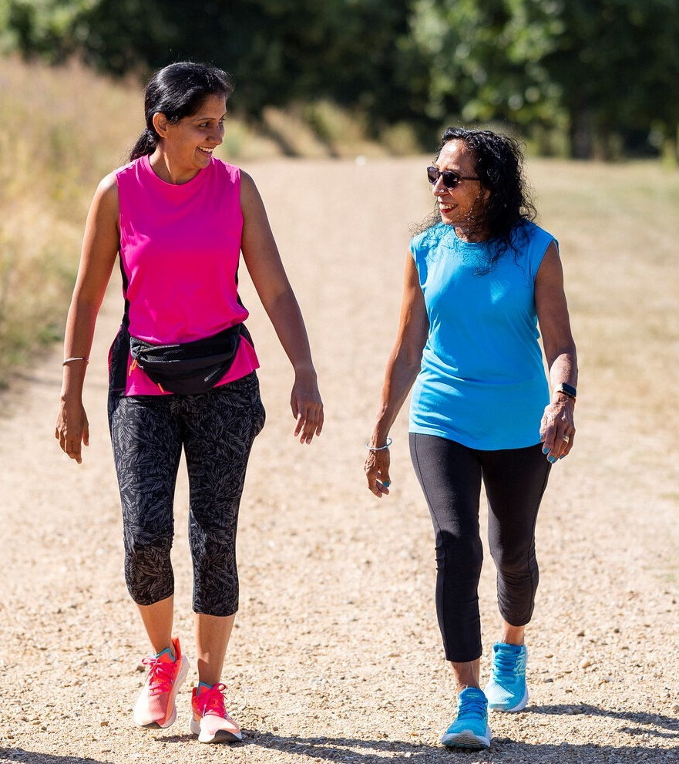



‘Walk & Talk’ Groups
Meet other carers and take a stroll around a local green area close to you.
You will get a chance to enjoy being outdoors in the company of other carers.
One of our friendly support workers will lead the walk, offer a listening ear, and provide information to support you in your caring role.
How do I join a walking group?
Give us a call on 07742 291 073 or contact CarersLine on 0117 965 2200
You can also email us at: walk@carerssupportcentre.org.uk
www.carerssupportcentre.org.uk
Notes:
Slide 5

